Slide 1
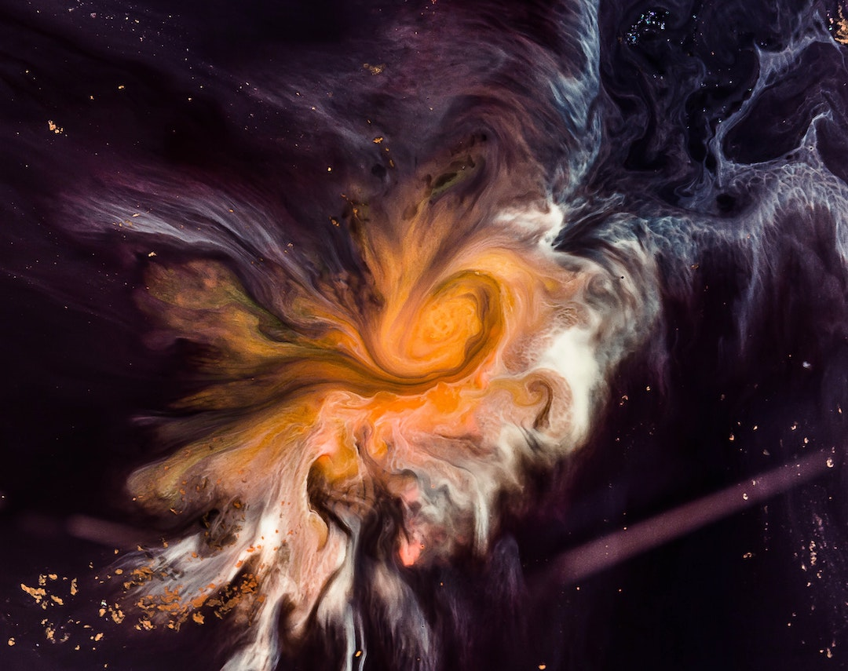
SPACE TITANIC
Incident Report
By Will Johnson
https://github.com/mailliwJ/spaceTitanic

Slide 2
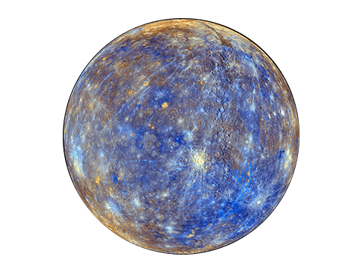
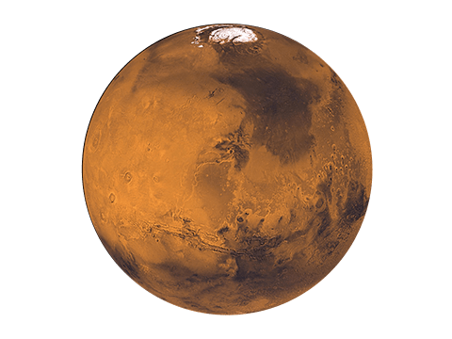
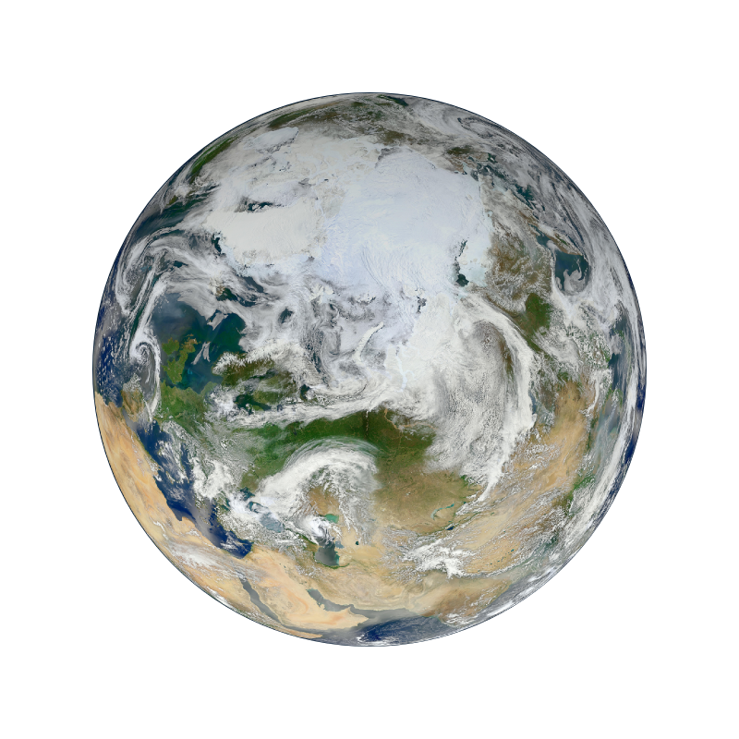
What?
What was this project about?
What was the business task?
What was the technical task?
2. So What?
What I did with the dataset
Key info from EDA
Modelling process
3. What now?
Addressing the technical task
Addressing the business task

Slide 3
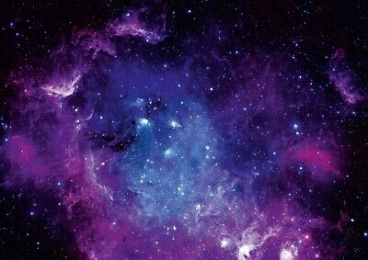
What?
Business Task:
Suggest where to focus initial investigations into which systems or parts of the ship caused the incident
Technical Task:
Produce a model capable of predicting with minimum 80% accuracy a passengers ‘Transported’ status
Use this model to make suggestions / recommendations to address the business task

Slide 4
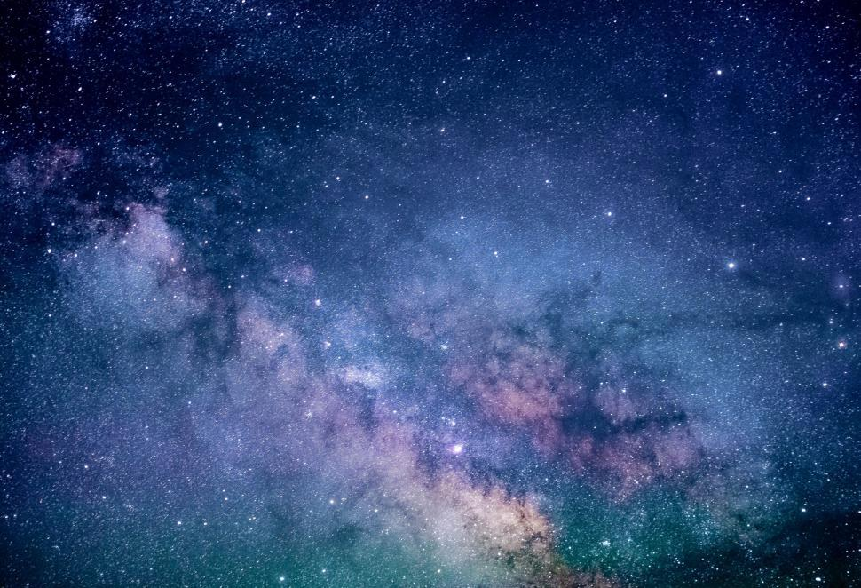
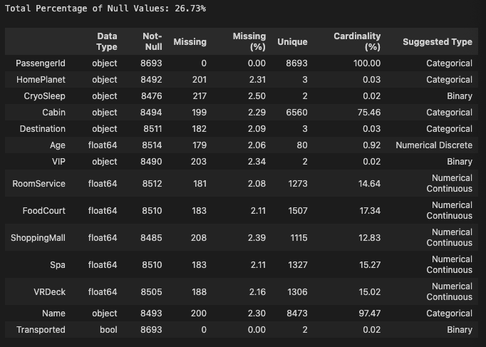
So What?
The Dataset
Train set:
8693 instances
14 features
Missing:
Only 2 clean features

Slide 5
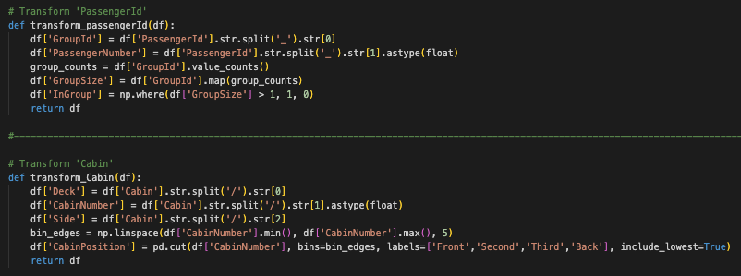
Cleaning & Imputation
So What?

Slide 6
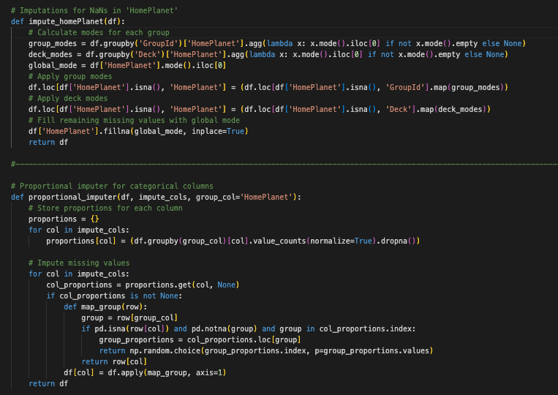
HomePlanet and categorical features
So What?

Slide 7
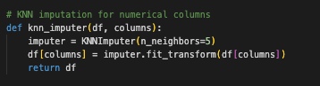
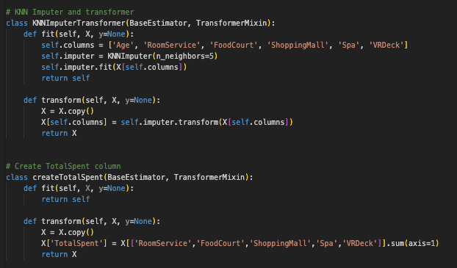
KNN for Numerical features
So What?

Slide 8
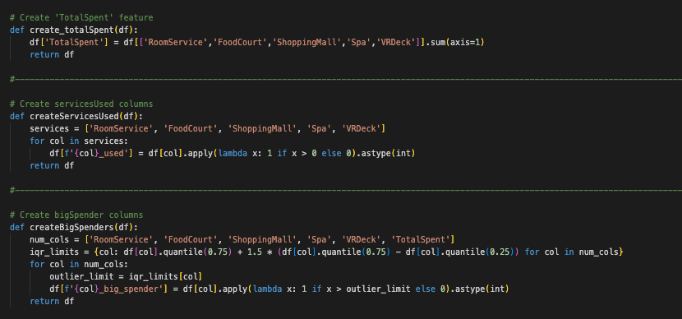
Feature creation
So What?

Slide 9
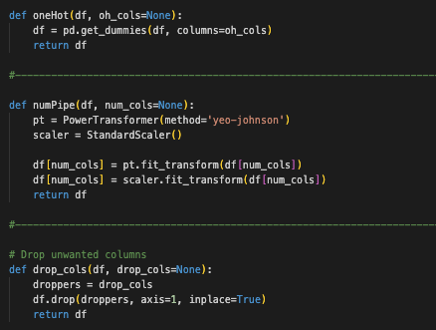
Encoding and treatment
So What?

Slide 10
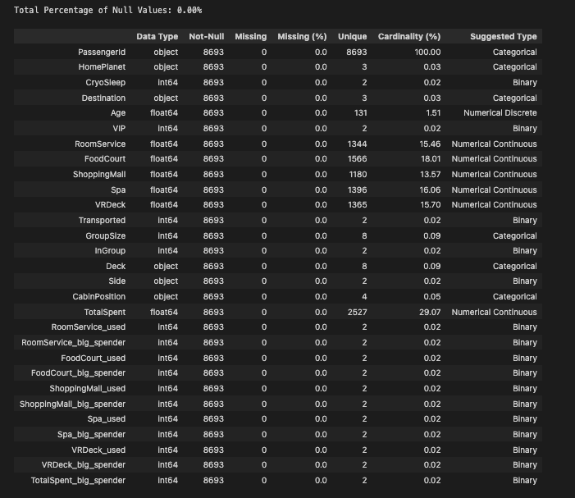
Cleaned and processed dataset
So What?

Slide 11
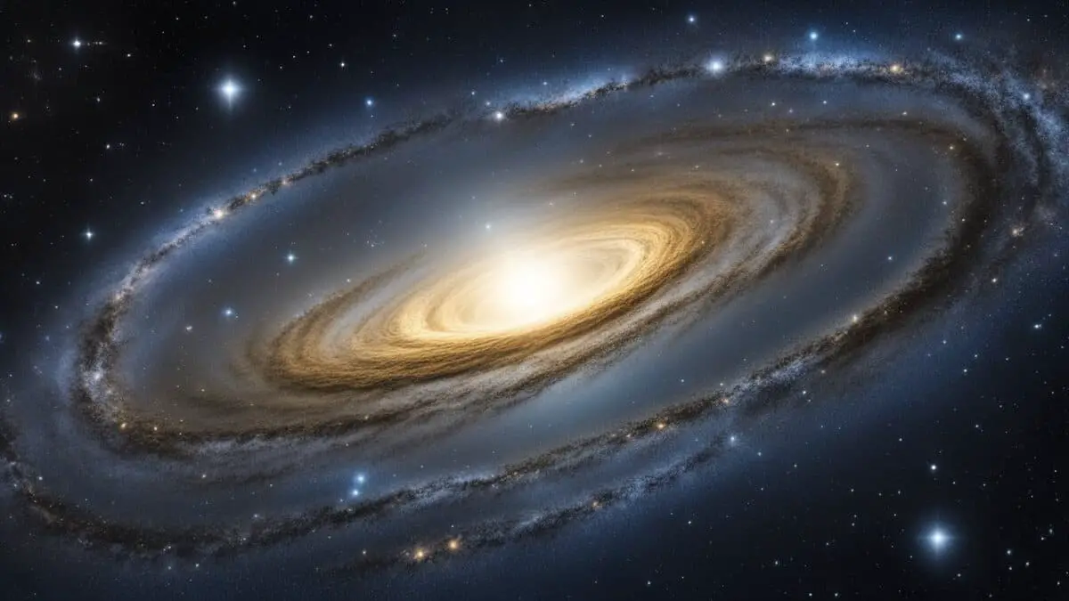
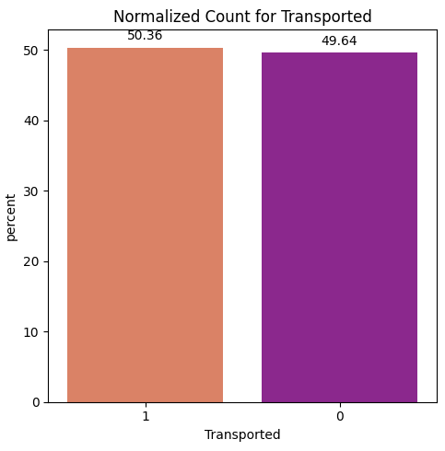
Key info from EDA

Slide 12
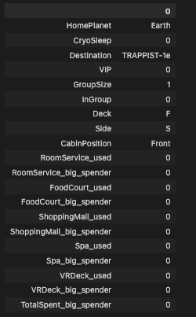
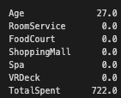
Average passenger
So What?

Slide 13

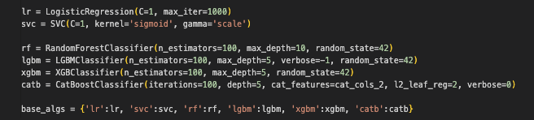
Modelling Process
PassengerId
HomePlanet
CryoSleep
Destination
Age
VIP
RoomService
FoodCourt
ShoppingMall
Spa
VRDeck
GroupSize
InGroup
Deck
Side
CabinPosition
TotalSpent
RoomService_used
FoodCourt_used
ShoppingMall_used
Spa_used
VRDeck_used
RoomService_big_spender
FoodCourt_big_spender
ShoppingMall_big_spender
Spa_big_spender
VRDeck_big_spender

Slide 14
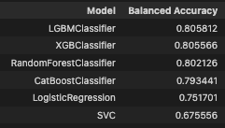
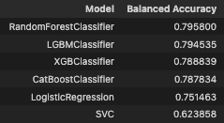
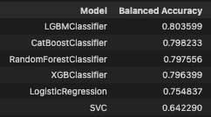
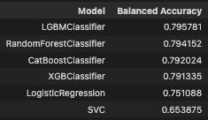
Feature Selection Methods
No feature selection
RFE
SelectPercentile
SelectKBest
Mutual_info
CONTINUE WITH:
No feature selection
Original set of features

Slide 15
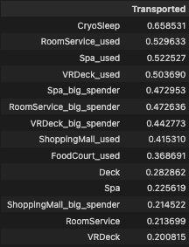
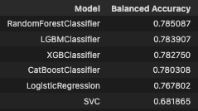
Phik correlation selection

Slide 16
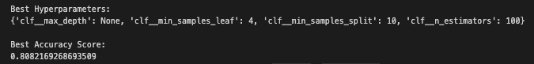
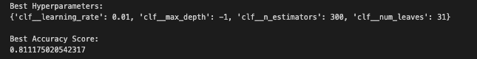
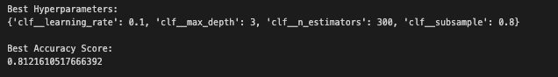
Hyperparameter Tuning
Random Forest
Light GBM
XGBoost

Slide 17
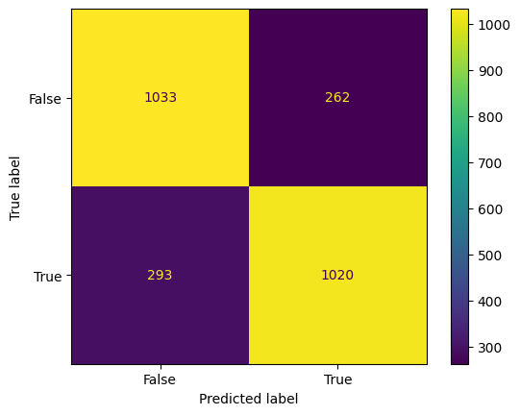
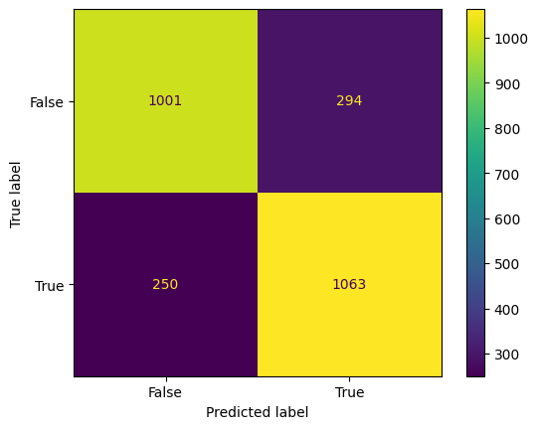

What Now?
What now?
Random Forest
Light GBM
XGBoost
Accuracy: 79%
Accuracy: 79%
Accuracy: 80%
slightly more false negatives than false positives
slightly more false positives than false negatives
slightly more false positives than false negatives

Slide 18
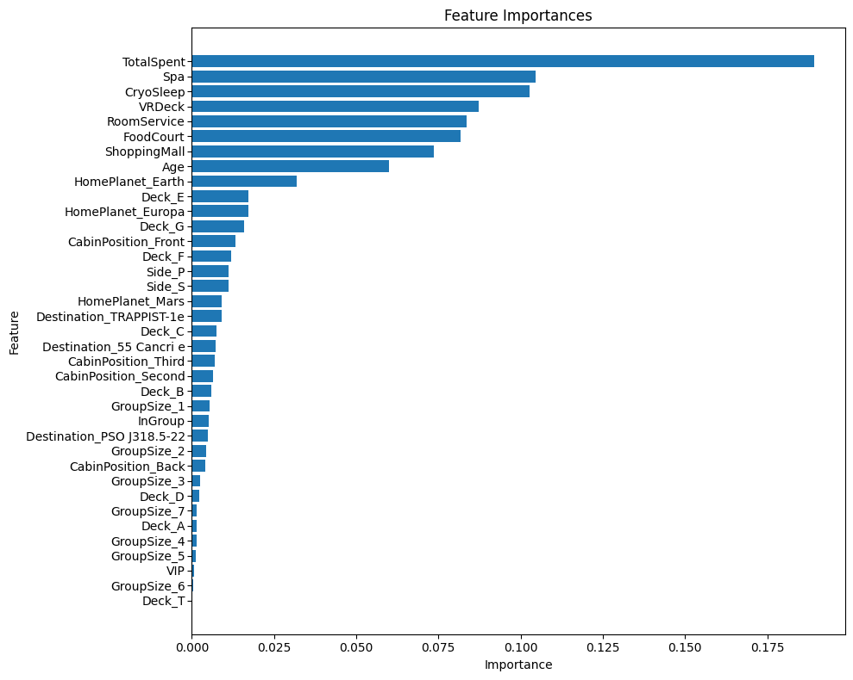
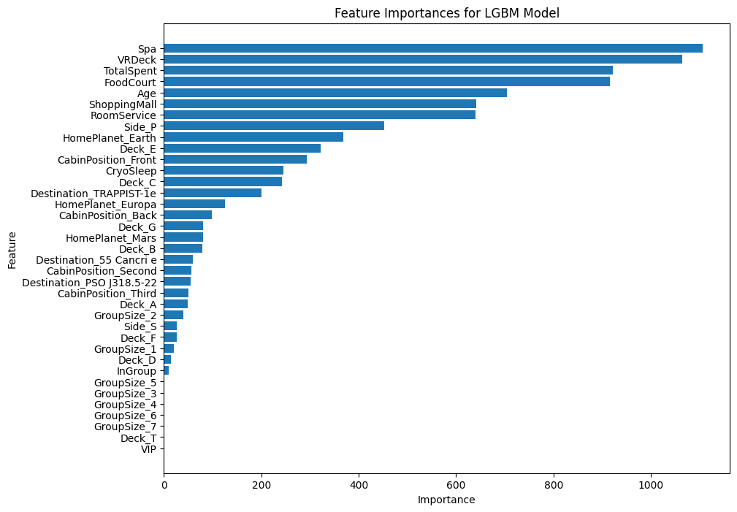
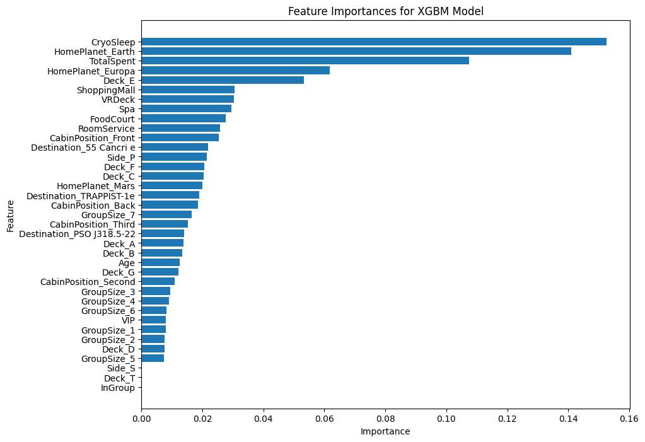
Feature Importances
What now?

Slide 19
Feature Importances
What now?
Random Forest
Light GBM
XGBoost
TotalSpent
Spa
CryoSleep
VRDeck
RoomService
Spa
VRDeck
TotalSpent
FoodCourt
Age
ShoppingMall
CryoSleep
HomePlanet: Earth
TotalSpent
HomePlanet: Europa
Deck: E
ShoppingMall
VRDeck
Spa

Slide 20
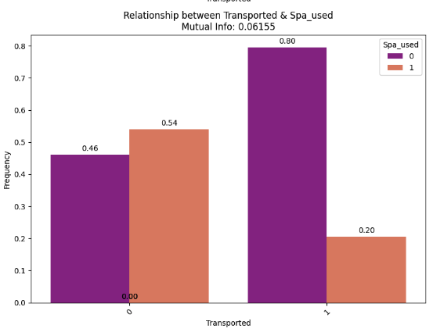
Safe in the Spa
What now?
Large decrease in proportion of those transported off the ship for spa users

Slide 21
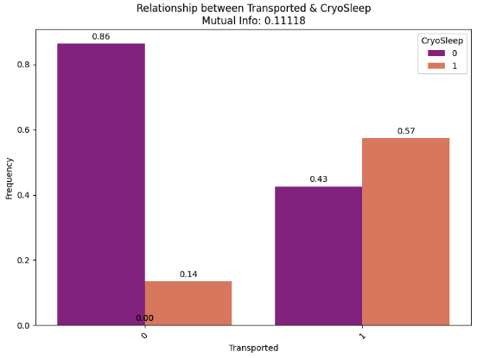
CryoSleep danger
What now?
Large increase in proportion of those in CryoSleep for passengers that were transported off the ship

Slide 22
Back to business
What now?
Focus investigations on:
Association between those that were spending money and therefore time out of their rooms and not being Transported. Look more closely at the rooms of those that were transported off the ship. In particular, cabins on Deck E
CryoSleep seems to have been an important factor in determining if a passenger was Transported off and therefore likely that there could have been a fault in the CryoSleep system

